Slide 1
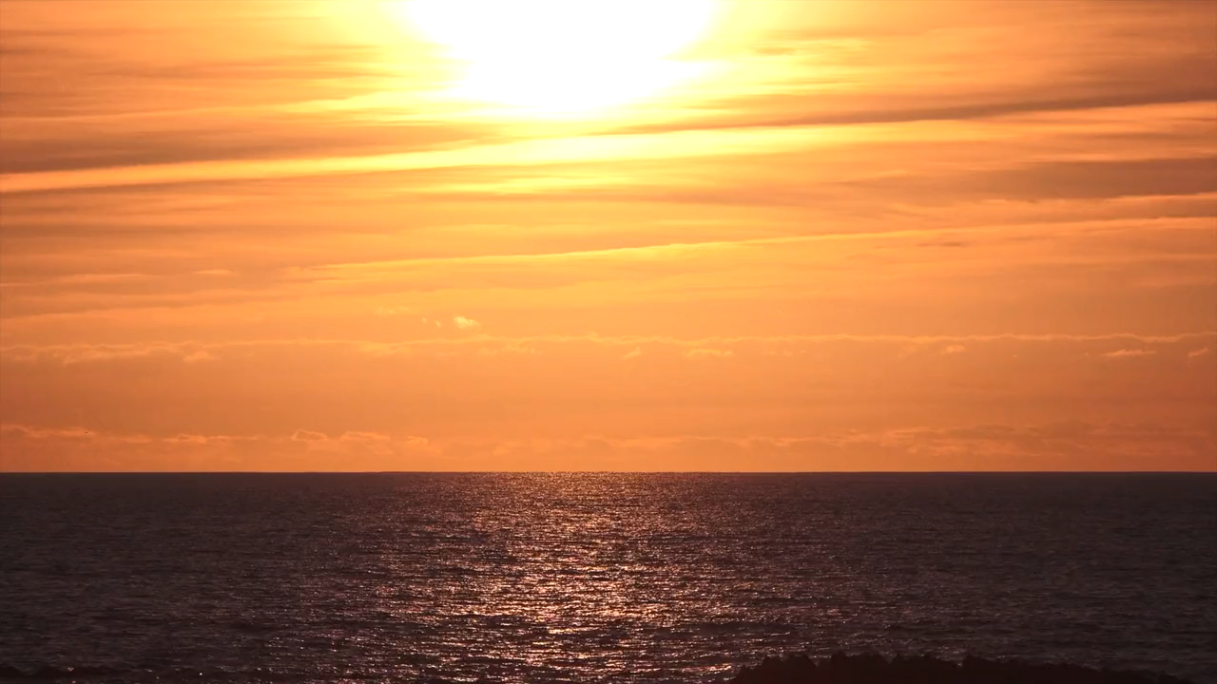
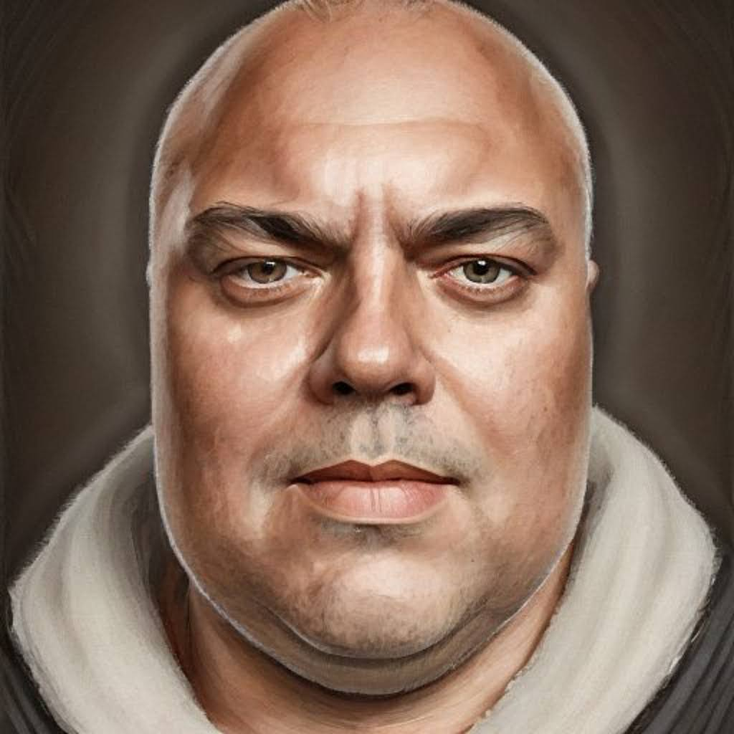
WWW.GIRAL.DO
SERGIO@GIRAL.DO
SERGIORGIRALDO
SERGIORGIRALDO
THANK YOU.
QUESTIONS? DOUBTS?

Slide 2
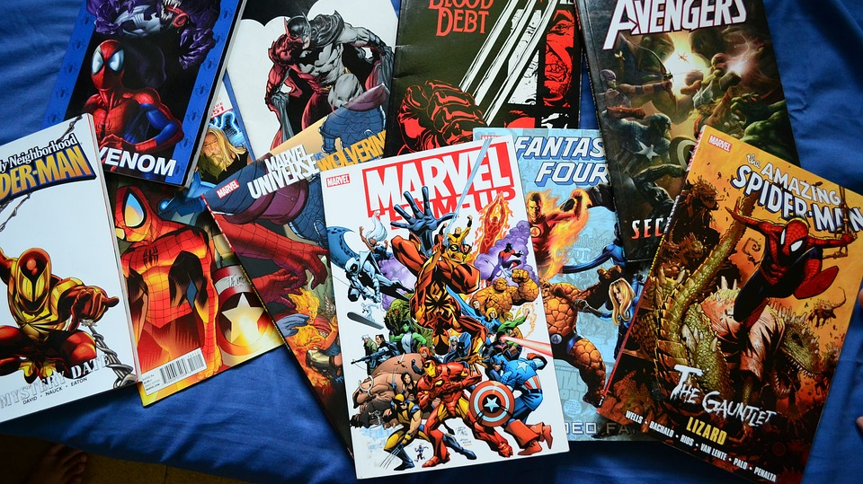

Slide 8
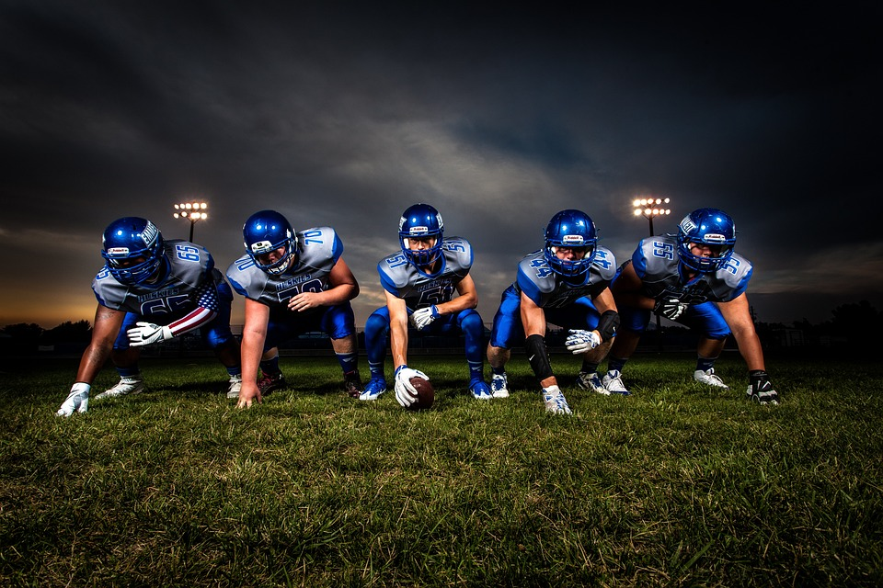

Slide 10
JOSE DA SILVA

Slide 11
JOAO DA SILVA

Slide 12
CARLOS DA SILVA

